Slide 1
Cyber Security
Apr 23 - Week 1

Slide 2
Topics
# Self intro
# Recalling the computer
# Introduction to Cyber Security
# FOSS

Slide 3

Self Intro
Name : Vignesh Kannan
VGLUG Volunteer for last 5 years.
System Engineer at TCS, Chennai.
Experience 2 Years
Mailam Engineering College - 2020

Slide 4
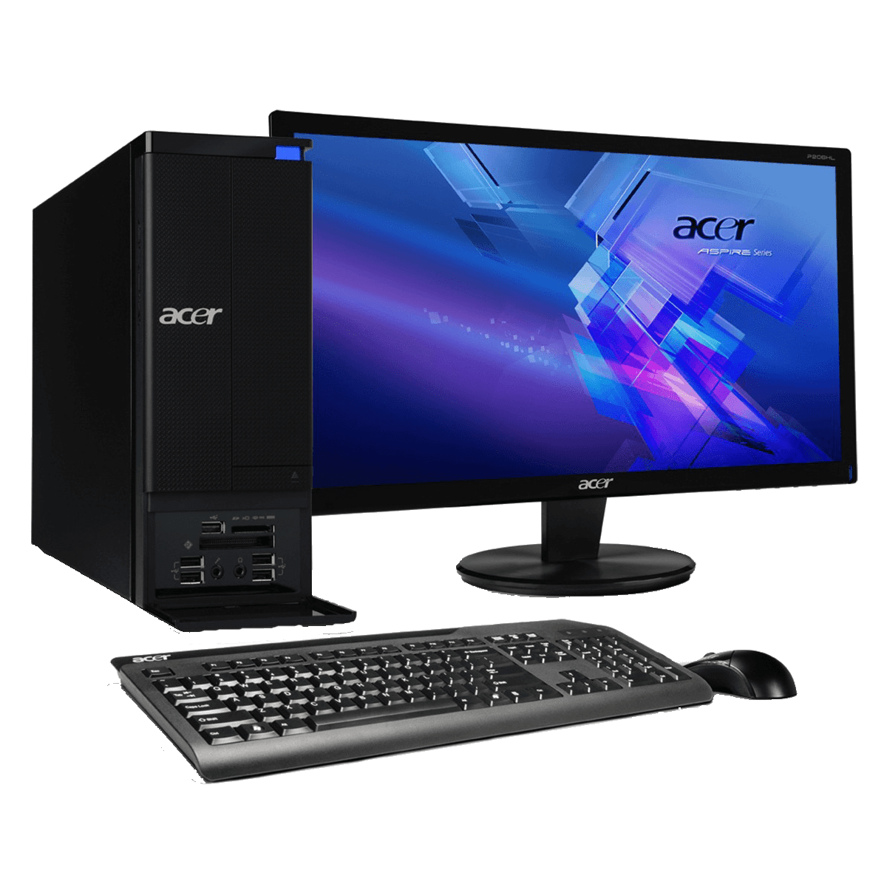
Recalling the computer
Hardware:
- Monitor
- Keyboard
- Mouse
- Trackpad
- Speaker
- Printer

Slide 5
Continued
CPU
- Processor (Intel, AMD)
- RAM (Memory)
- ROM (HDD-hard disk drive, SSD - Solid-state drive, NVMe - nonvolatile memory express)
- SMPS - switched-mode power supply
- Motherboard
- SATA
- Fan

Slide 6



Continued
Software:
- Operating System (Linux,Mac,Windows)
- Applications
Network:
- RJ45 (Network port, LAN cable)
- Network Switch
- Router

Slide 7
Introduction to Cyber Security
What is Cyber Security?
Security and Safety
Cyber security refers to the body of technologies, processes, and practices designed to protect networks, devices, programs, and data from attack, damage, or unauthorized access.
We must protect our computers and data in the same way that we secure the doors to our homes.
We must behave in ways that protect us against risks and threats that come with technology.

Slide 8
What kinds of Threats are there?
Phishing
Social Engineering Scams
Common Malware and Ransomware
Business Email Compromise
Fake websites that steal data or infect devices
And much more

Slide 9
2023 QUALYS TRURISK RESEARCH REPORT

Slide 10
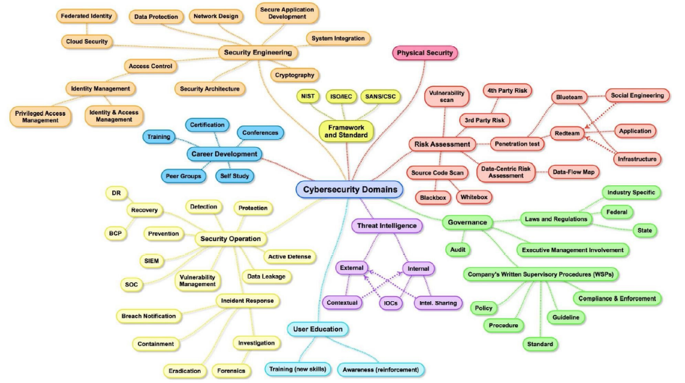

Slide 11





FOSS
Free and Open Source Software
open source operating system, released under the GNU General Public License (GPL). Anyone can run, study, modify, and redistribute the source code, or even sell copies of their modified code, as long as they do so under the same license.

Slide 12
VGLUG Contribution to FOSS
Sangailakkiyam – An android application which is used to read all literature from the Sangam era.
Mozilla Localization in tamil – we enriched mozilla and its product into tamil localization.
Spell4Wiki – It is a eminent resource for Wikipedia where people can give the voice sample for words in Wikipedia. This app also act as Wiki – Dictionary.

Slide 13
Continued
Dr. RavikumarMP App – This connects the Member of Parliament to the people of Villupuram constituency to raise obligations, suggestions and complaints.
VizhiTamilApp – App helps to visually impaired people to listen Tamil Books by using image to text technology.

Slide 14
Task
Account Creation
tryhackme.com
www.hackthebox.com

Slide 15
Github
https://github.com/vigneshkannan255/vglug_cybersecurity

Slide 16
Thank You

